Slide 1
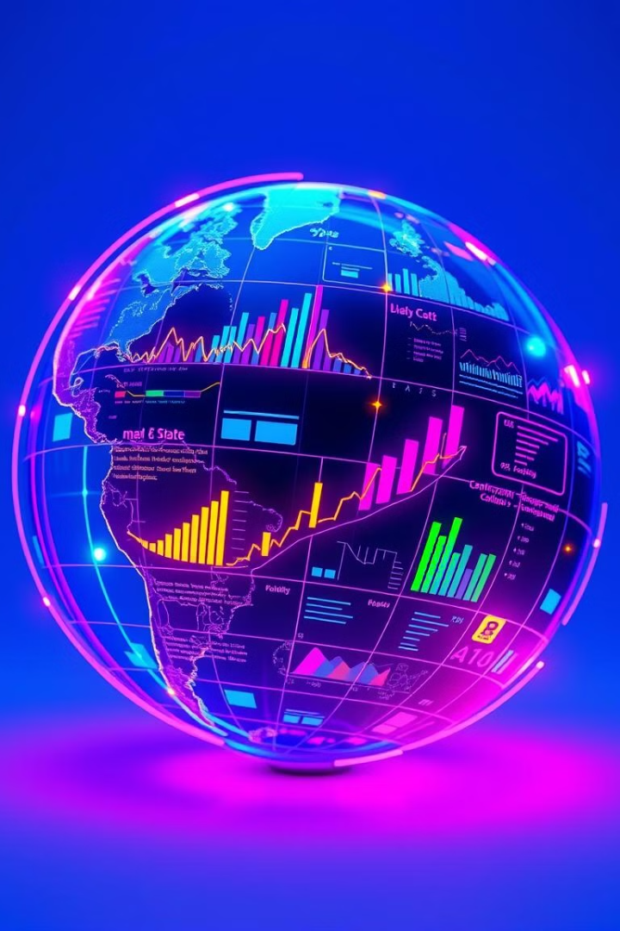
🌎 Global Market Trends Analyzer
This presentation introduces Global Market Trends Analyzer, a powerful data analytics tool designed to provide real-time market insights and facilitate strategic decision-making for businesses.
Presented by : Team 1
Harshith Sai
Dumpati Ravali
Vanishree Srinivas

Slide 2
About the Application
Purpose
Features
Analyze global market trends and data to inform strategic decisions.
User Registration and Authentication
Market Data Upload and Visualization
Trend Analysis
Search and Comparative Analysis
Admin CRUD Operations

Slide 3
Application Navigation
Login/Register
1
Secure user authentication for access.
2
Dashboard
Upload and visualize market data.
Trend Analyzer
3
Analyze market trends and patterns.
4
Search & Comparative Analysis
Compare market data across companies.
Admin Dashboard
5
Perform CRUD operations on data.

Slide 4
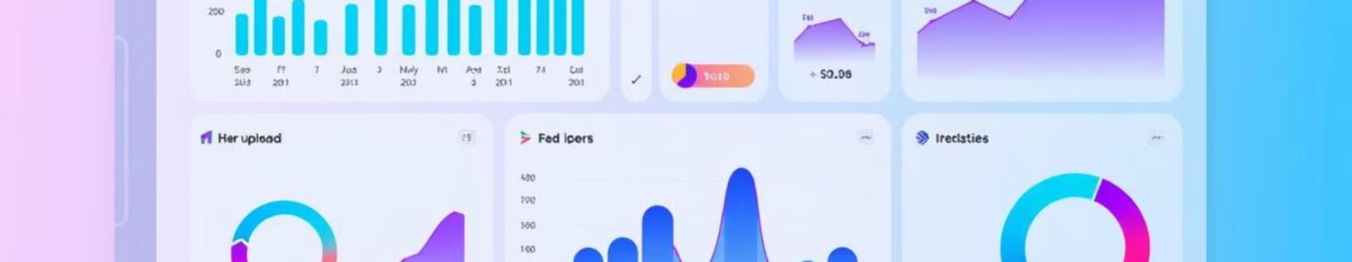
Feature Highlights
1
Login & Registration
2
Dashboard
3
Trend Analyzer
User authentication using session states.
Upload CSV data and visualize it with charts.
Filter data by date range or region, generate correlation matrix and heatmap.

Slide 5
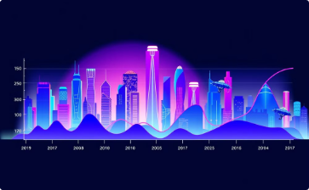
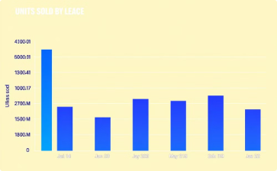
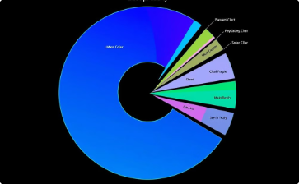
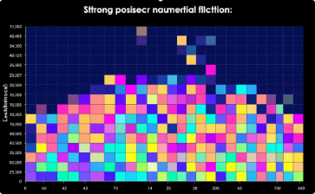
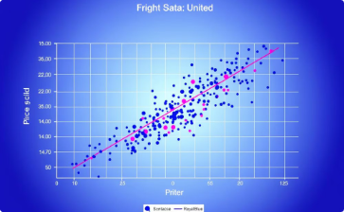
Interactive Visualizations
Line Chart
Bar Chart
Pie Chart
Heatmap
Trend of Units Sold
Units Sold by Date
Market Share by Category
Correlation of Numerical Data
Scatter Plot
Price vs Units Sold

Slide 6
Backend Architecture
Database
API Integration
Machine Learning
SQLite for storing market data, CRUD operations for admin management.
Fetch real-time market data using Financial Modeling Prep API.
Predictive analysis for trends using scikit-learn.

Slide 7
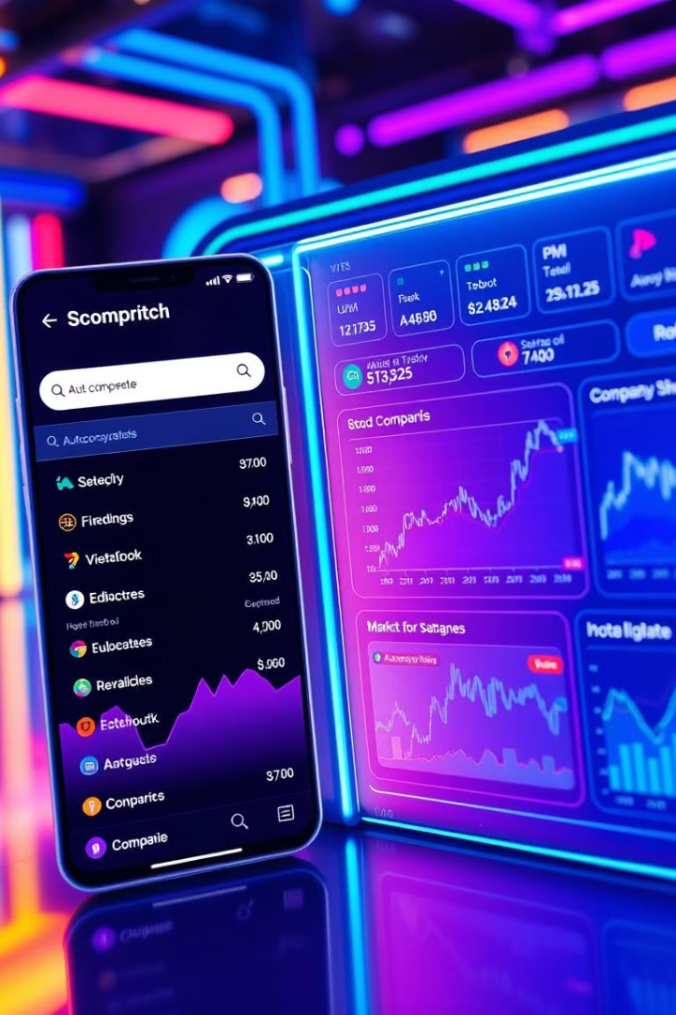



Advanced Analysis Module
Search
Search specific company symbols for analysis.
Compare
Compare data for multiple companies side-by-side.
Visualize
Display trend line graphs and market share visualizations.

Slide 8




Admin Dashboard
1
CRUD Operations
2
User Management
3
Data Updates
4
Analytics

Slide 9
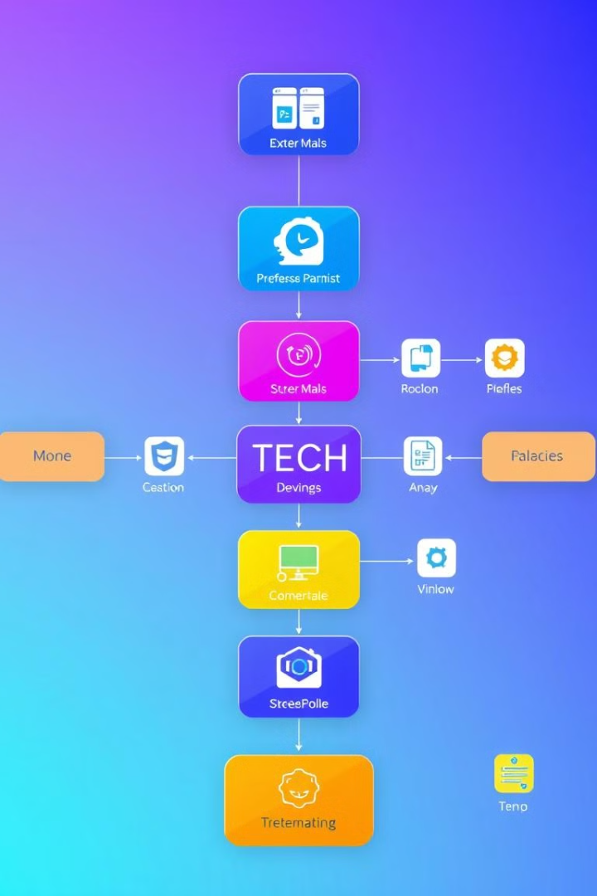



Tech Stack
Frontend
Backend
Streamlit
FastAPI, SQLite
Visualization
Machine Learning
Matplotlib, Seaborn, Plotly
scikit-learn

Slide 10

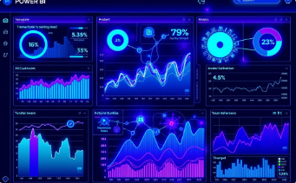

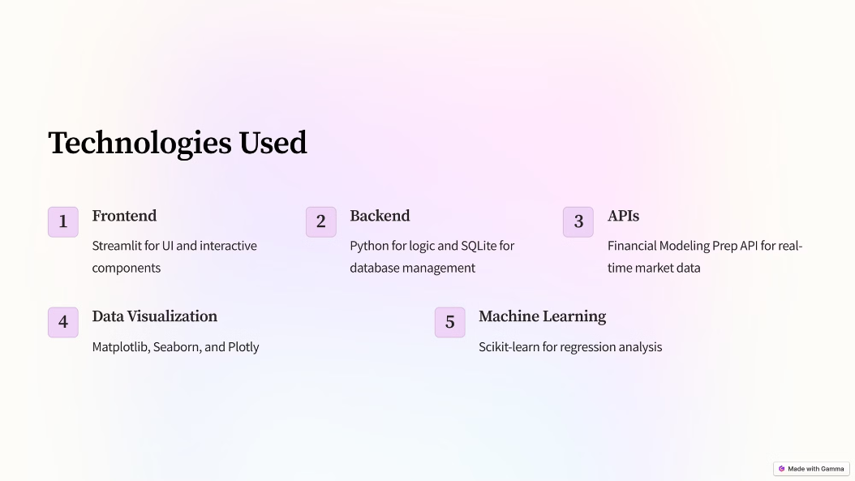
Contribution By The Team Members
Backend Development
Data Visualization
Technologies Used
Python + APIs
Matplotlib, Seaborn, Plotly
Streamlit

Slide 11

THANK YOU!!!

